Slide 1

Library Management System
Welcome to our presentation on Library Management System. Discover the solution that simplifies library operations and enhances user experience.

Slide 2
Team Members
Rajvir Saini
Akash Ks
Krishna
Dhiraj Chauhan

Slide 3
Abstract
The Library Management System automates library processes, simplifies resource management, and enhances user satisfaction. With its user-friendly interface and advanced features, the system streamlines operations, making it easier for librarians and patrons. It provides seamless access to resources, promotes efficient borrowing and returning, and enables users to explore a wide range of materials. The system offers personalized recommendations and a user-friendly search interface, ensuring an enjoyable library experience. It's the perfect tool for enhancing library services and providing an exceptional user experience.

Slide 4
Objectives
1
Streamline Operations
Optimize workflows to simplify cataloging, borrowing, and returning processes.
Improve Accessibility
2
Enhance user experience with intuitive user interfaces and online access to resources.
3
Ensure Data Security
Implement robust security measures to protect user information and library assets.

Slide 5
Features Implemented
1
Remember Login Credentials
Allows users to save their login details for future use.
Search Function
2
Enables users to search for specific items or information within the system.
3
Borrow and Return
Allows users to borrow and return items from the library.
OTP Verification
4
Provides an extra layer of security by verifying users through verification links, ensuring that only authenticated users can log in.

Slide 6
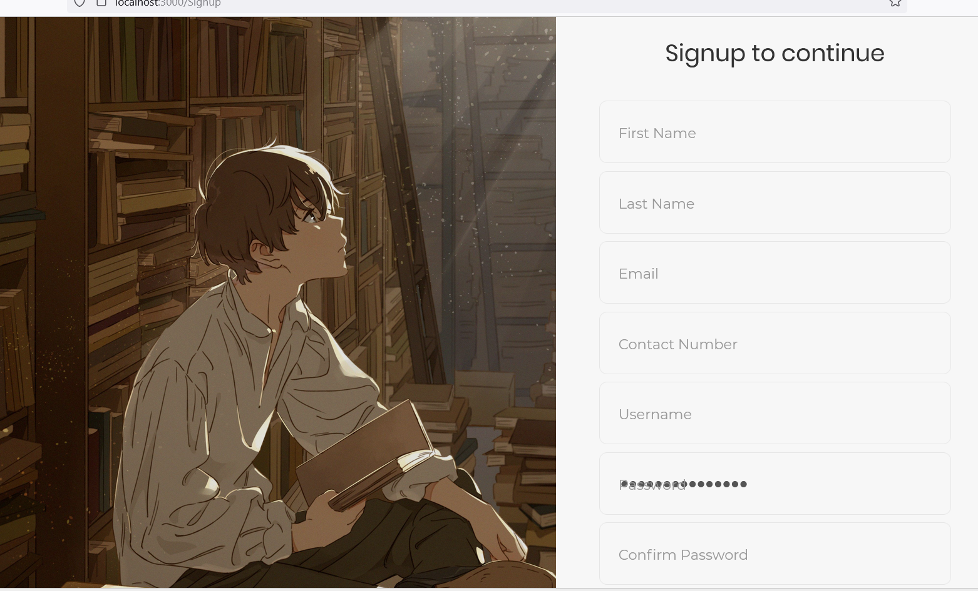
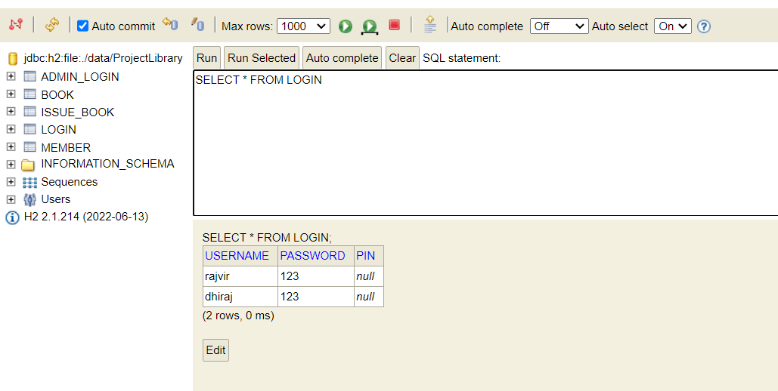
Otp verification:

Slide 7
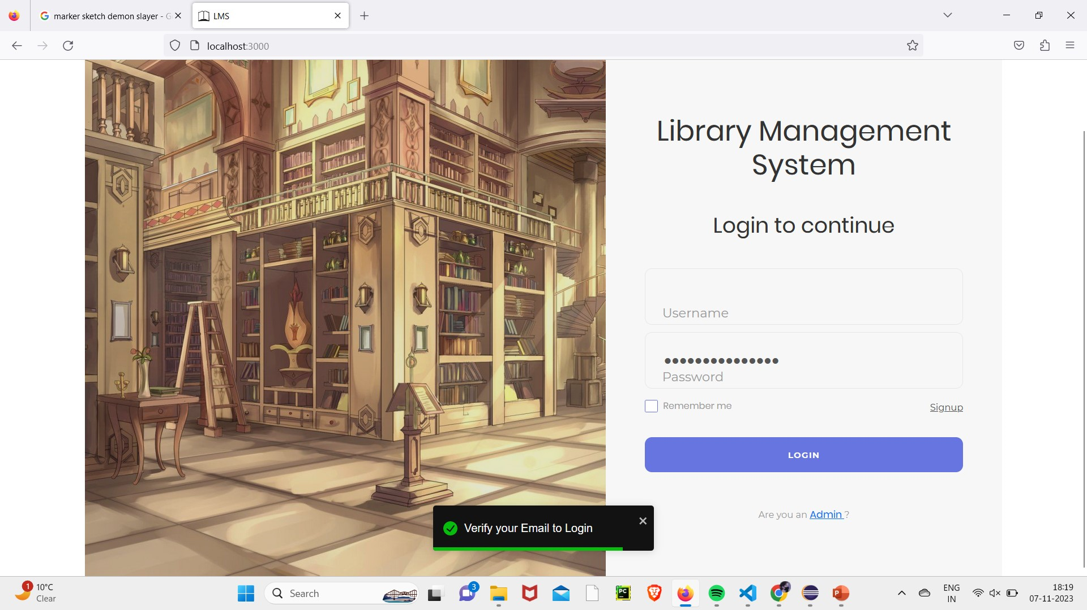
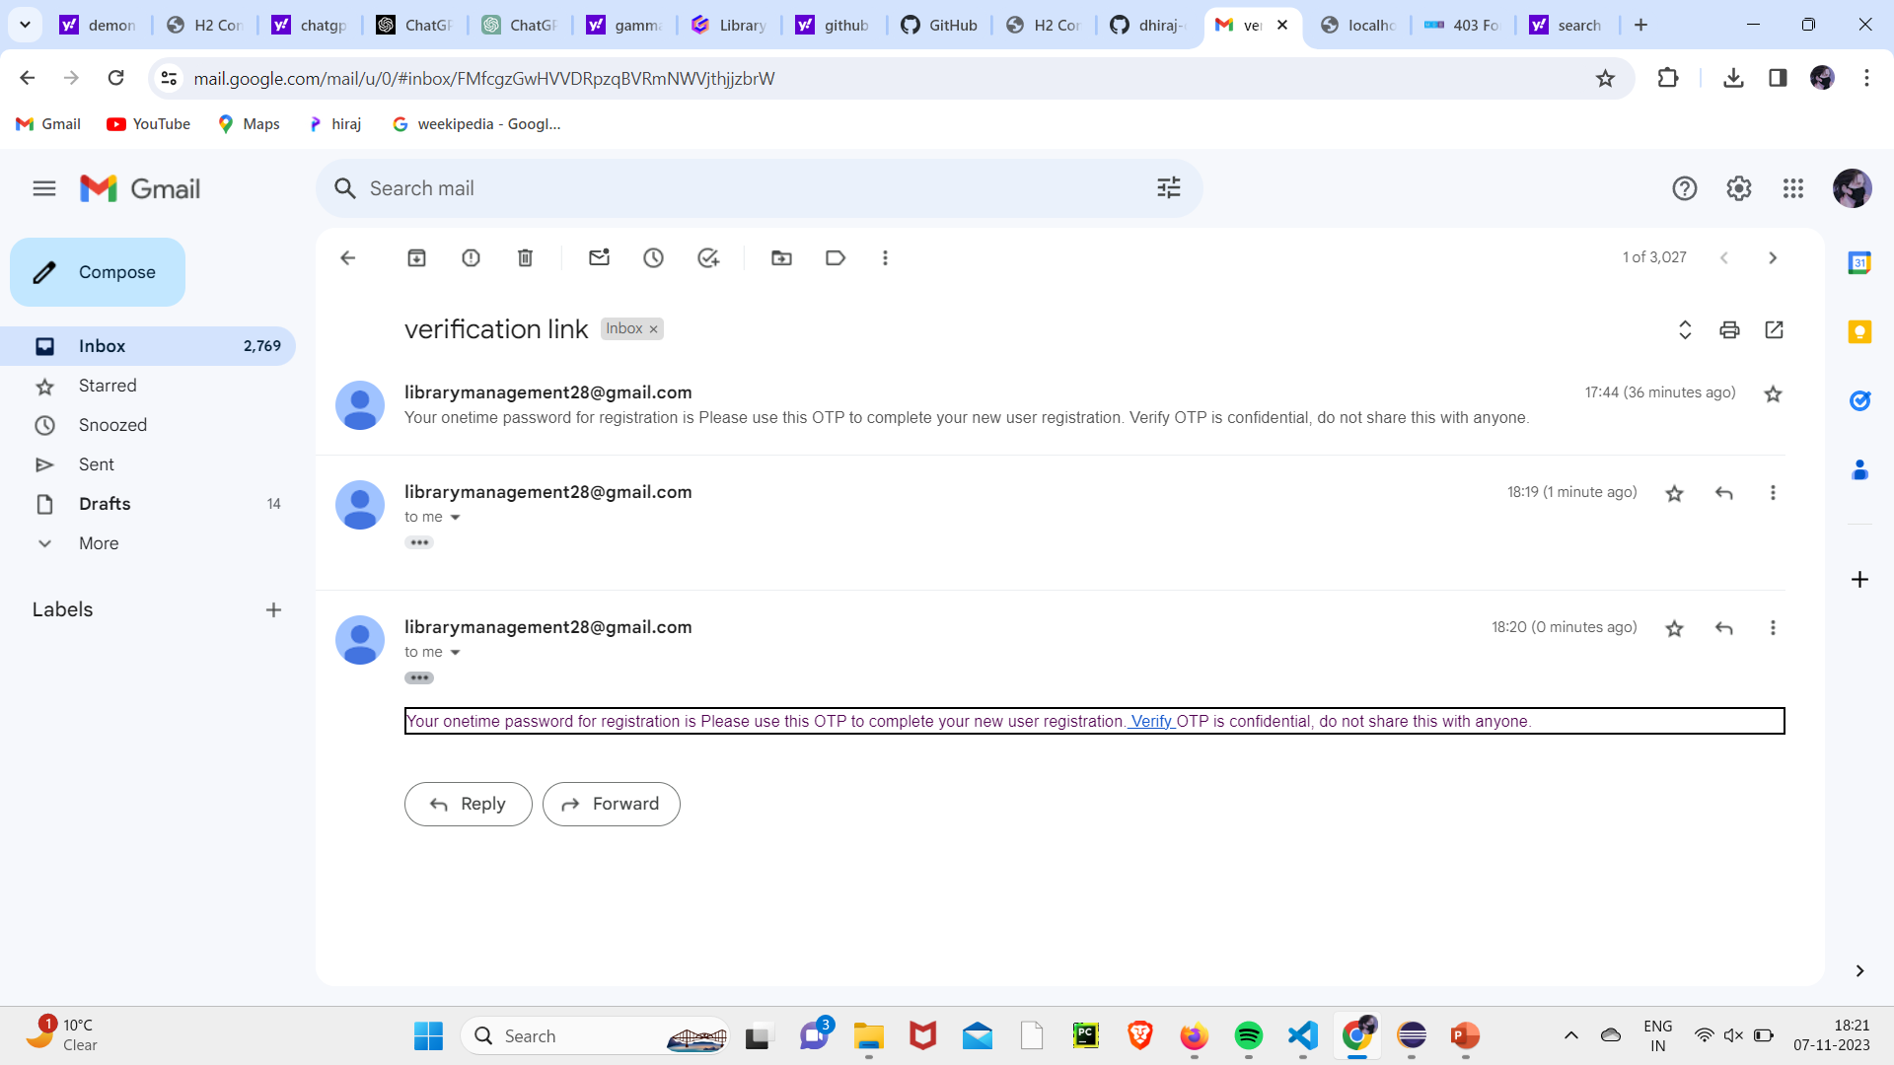

Slide 8
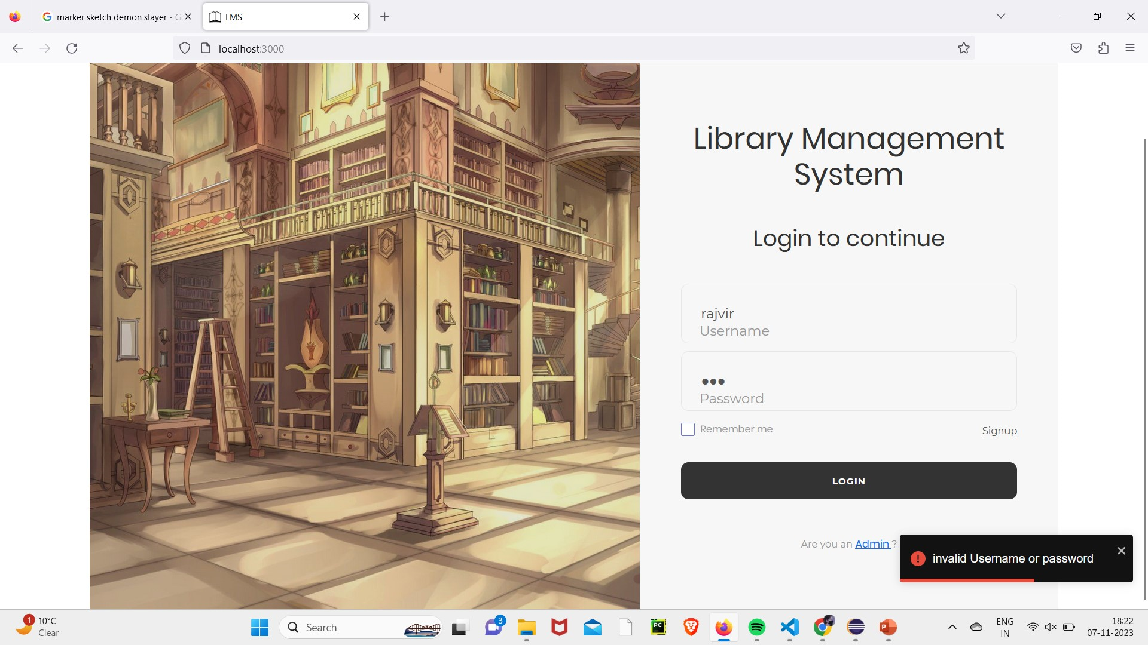
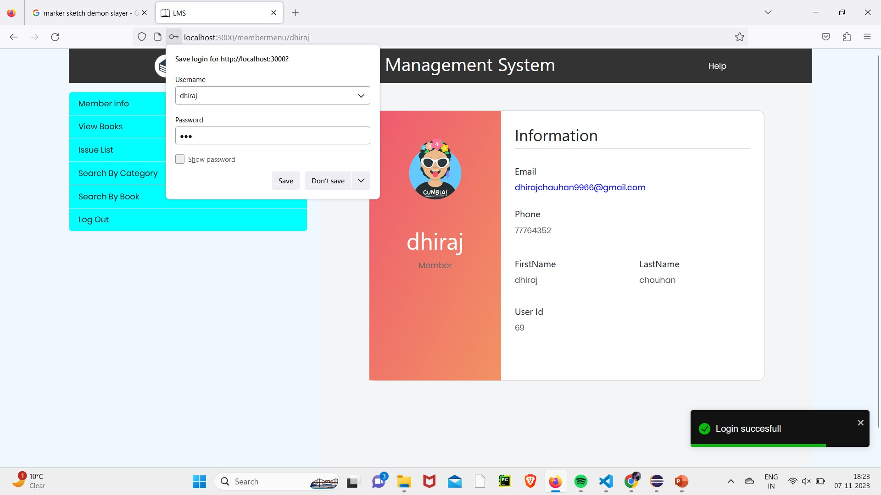

Slide 9




Tools Used
Programming Languages
Java, JavaScript, HTML, CSS
Frameworks & Libraries
Spring Boot, React, Bootstrap.
Database
H2

Slide 10
Thank You

